Slide 1
Byte Pair Encoding for Chinese Model
Yizuo SONG
Instructor: Qiufeng WANG

Slide 2
Outline
Background:
Byte Pair Encoding
Related works:
Current BPE models
Methodology:
Inverse Character Frequency BPE
Application :
NMT model for BPE
Conclusion
Future works

Slide 3

Background
Byte pair encoding
Motivation
Method
Example

Slide 4
Byte Pair Encoding: Motivation
Out of Vocabulary:
Words classes are translatable via smaller units than words.
By encoding rare and unknown words as sequences of subword units, the NMT model will be capable of open-vocabulary translation
Smaller model size:
BPE have being used in Chinese model. One of these models focuses on using BPE to improve granularity^{[3]}.
In their study, they stated that Character embedding model will occupy state space exponentially according to sequence length.

Slide 5
Byte Pair Encoding: Method
Original Byte Pair Encoding^{[1]} is an algorithm for data compression introduced by Gage in 1997.
In Neural Machine Translation of Rare Words with Subword Units by Sennrich et al. ^{[2]} ,BPE is used to solve out of vocabulary issue.
The main difference to other compression algorithms, such as Huffman encoding, is that BPE are still interpretable as subword units, and that the network can generalize to translate and produce new words (unseen at training time) on the basis of these subword units.

Slide 6
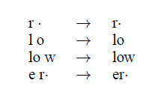
Byte Pair Encoding: Example
The intuition for of this application of BPE is that meaning of words in English is carried out by smaller subword, which also appears in other related word^{[2]} . Lower here is out of vocabulary and is interpreted as low+er.
BPE merge operations learned from dictionary ^{[2]}
{‘low’, ‘lowest’, ‘newer’, ‘wider’}.
“·” represent end of word

Slide 7
Related works
Subword-nmt
YouTokenToMe
Sentence-piece
FMDL

Slide 8
Subword-NMT
Published in Neural Machine Translation of Rare Words with Subword Units, ^{[2]}
They introduce BPE into NLP to solve Out-of-vocabulary issue. This is the baseline of most BPE project. They choosed an NMT model ^{4]} as downstream task to test out the result of BPE model
Sennrich et al. ran baseline for English-Russian and English-Germany in WMT 2015 dataset.

Slide 9
YouTokenToMe
YouTokenToME ^{[5]} or YTTM is an improved version of FastBPE, which is basic Subword-nmt in C to improve speed. Still uses subword algorithm.
YouTokenTome did not state any baseline for downstream task.
It should give similar result with subword-nmt.
YTTM gives speed baseline for single language Wiki corpus. For Russian English Chinese and Japanese.

Slide 10
Sentence-Piece
Trains from raw sentences, while other BPE algorithm need to train from tokenized text.
Opensource project
Still uses original Subword algorithms. But Sentence-piece should perform better in en-zh model since sentence-piece encoding all symbols in Unicode and support language with large vocabularies better.

Slide 11
FMDL
FMDL considers more than BPE given the minimal coding cost in vocabulary.^{[6]} .
Their task was NMT but the exact downstream project wasn’t given.
FMDL ^{[6]} provided baseline on Asian Scientific Paper Excerpt Corpus.
ASPEC consists of a Japanese-English paper abstract corpus of 3M parallel sentences (ASPEC-JE) and a Japanese-Chinese paper excerpt corpus of 680K parallel sentences (ASPEC-JC).

Slide 12

My proposal of BPE
for Chinese model

Slide 13
Inverse character-frequency BPE
Subwords are defined as meaningful component within a word, but normally not enough to be translated or comprehended.
In Chinese NLP, one possible reason character embedding have lower performances compared to word embedding because modern Chinese characters tends to show different meaning when composing words. Therefore, Chinese characters is equivalent to subwords.
English, however, is Phonogram and is consisted of subword and filling characters to pronounce.

Slide 14
Inverse character-frequency BPE
In Chinese, segmentation is quite different from English.
Chinese text contains only Meaningful Characters, which is equivalent to meaningful subwords, while English Words have filling characters between subwords.
From this, I proposed Inverse character-frequency BPE which is specific to Chinese.

Slide 15
Inverse Character Frequency BPE
Inverse Character Frequency BPE takes inversed character frequency into consideration to avoid meaningful single Chinese character, which is equivalent to words rather than subword in English, to be concatenated as subwords.
If we uses character embedding, characters with low frequencies will be hard to learn compared with high frequencies.

Slide 16
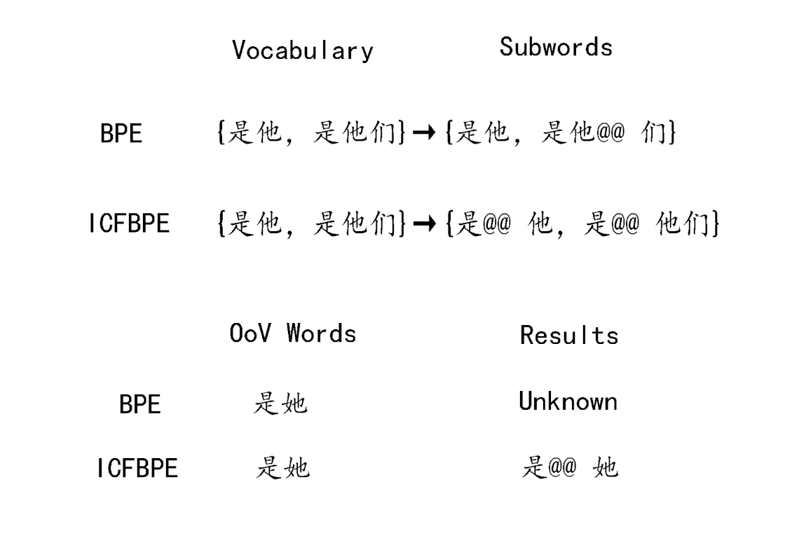
Example of ICFBPE

Slide 17
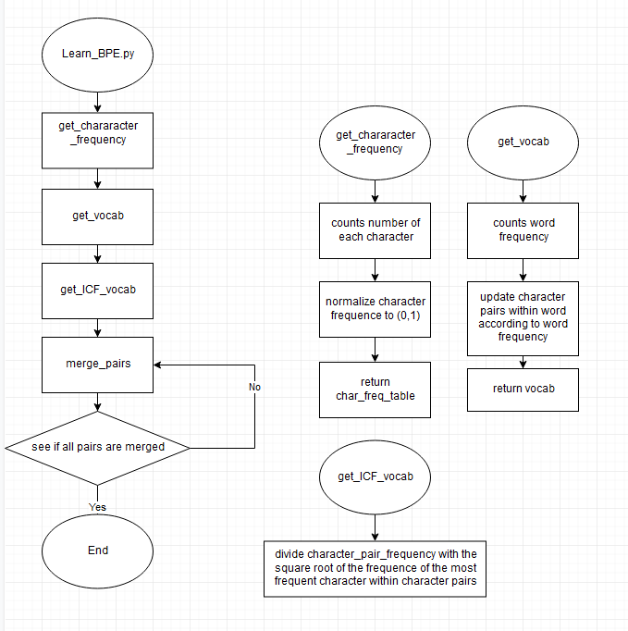


Inverse Character Frequency BPE
Why square roots

Slide 18
Inverse Character Frequency BPE
The general structure is still subword-nmt. The input vocab is the original subword-nmt vocab. This Inverse Character Frequency is inserted after vocabulary is counted and before the start of BPE.
In other word, BPE method is still the original BPE method from subword-nmt. The only different is that the counts of character pairs will be divided with the square root of the highest Character frequency of all characters within the character pair.
The square root is just to introduce non-linearity.

Slide 19
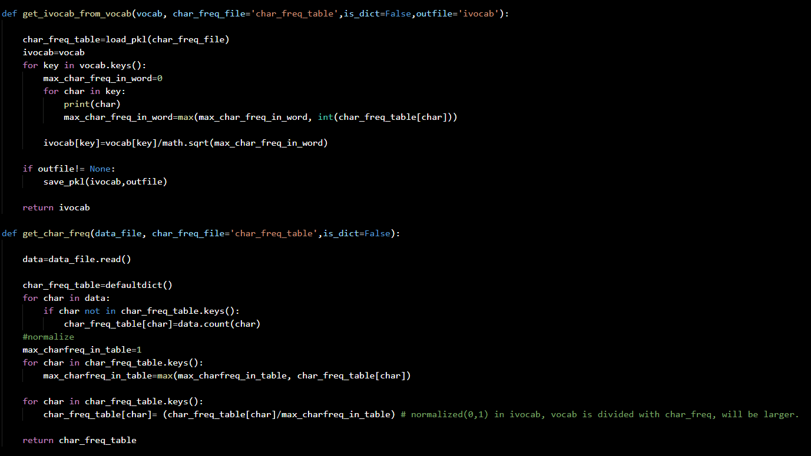
Inverse Character Frequency BPE
改成流程图

Slide 20
Applications of BPE

Slide 21
NMT model for BPE
Train a RNN encoder-decoder proposed by Cho et al. for comparison, and their own RNN search model.
RNN Encoder-Decoder have 1000 hidden units each for both encoder and decoder.
RNN search model have a forward and backward RNN with 1000 hidden units each.
Each model was trained twice first with sentence length up to 30 word and then with sentence length up to 50 word

Slide 22
NMT model for BPE
This is a NMT project created by Bahdanau et al. in 2014 published in “Neural machine translation by jointly learning to align and translate”
They train each of their language model with SGD and Adadelta for 5 days, to get better result for baseline.

Slide 23
NMT model for BPE
I didn’t have that much time since I need to train separately for all BPE models I intended to compare. Which would be 5 models with 2 language each, leading to 50 days of training time.
The training time in our school lab is around 2k updates in 48hours. Therefore, I have to cut maximum update from 1million to one thousand.
This will certainly lead to huge decrease in final result. However, I did manage to run an English to Germany model to compare result between a partially converged model with a fully converged model

Slide 24
Result

Slide 25
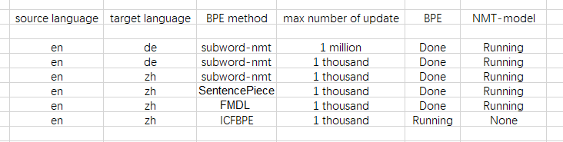
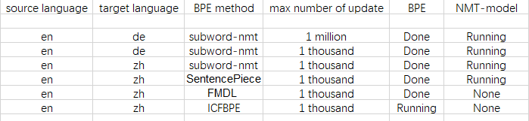
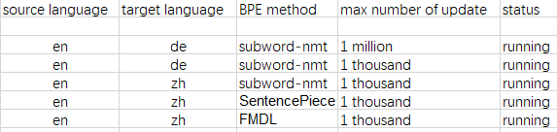
Results
Dataset used is UM corpus[7]

Slide 26
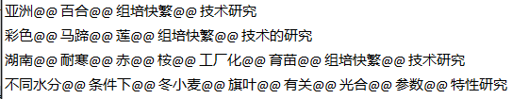
Subword-nmt

Slide 27
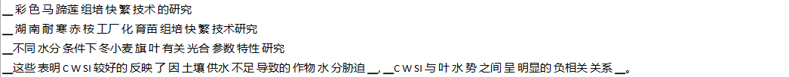
Sentence piece

Slide 28
Conclusion
English BPE and Chinese BPE have little in common
ICFBPE still need a tokenizer to segment Chinese data to create the vocabulary prototype in order to save time.
ICFBPE is inefficient and have high time cost in when obtaining Character frequency table from large datasets.

Slide 29
Contribution
Compare several BPE method on English to Chinese context
Proposed a new BPE method for Chinese NLP

Slide 30
Future works
Finish NMT models for all mentioned BPE algorithm
Test out ICFBPE to see whether non-linearity is actually needed.

Slide 31
References
[1] Gage, P. (1994), ‘A new algorithm for data compression’, C Users Journal 12(2), 23–38.
[2] Sennrich, R., Haddow, B. and Birch, A. (2015), ‘Neural machine translation of rare words with subword units’, arXiv preprint arXiv:1508.07909 .
[3] Wang, Y., Zhou, L., Zhang, J. and Zong, C. (2017), Word, subword or character? an empirical study of granularity in chinese-english nmt, in ‘China Workshop on Machine Translation’, Springer, pp. 30–42.
[4] Bahdanau, D., and Cho, K., and Bengio, Y. (2014), ‘Neural machine translation by jointly learning to align and translate’, arXiv preprint arXiv:1409.0473.

Slide 32
References
LREC
[5] Yutkin,D. et al. “VKCOM /YouTokenToMe .” Github.com. https://github.com/VKCOM/YouTokenToMe (accessed Nov. 18, 2020).
[6] Wang,H. “wang-h /FMDL.” Github.com. https://github.com/wang-h/FMDL(accessed Nov. 18, 2020).
[7]Tian,L. et al. 2014,” UM-Corpus: A Large English-Chinese Parallel Corpus for Statistical Machine Translation.”,LREC, p1837--1842

Slide 33
Q&A

Slide 34
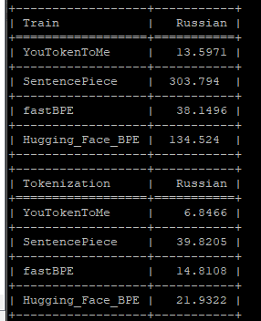
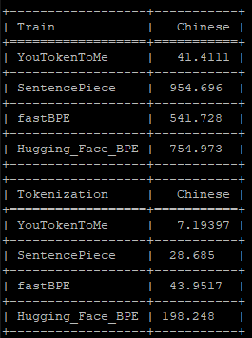
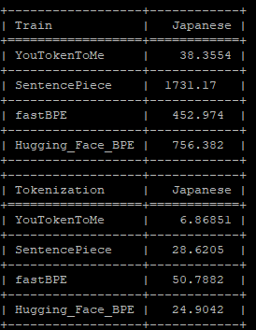
YouTokenToMe Speed test benchmark

Slide 35
Subword-NMT
In Neural Machine Translation of Rare Words with Subword Units, ^{[2]}
Sennrich et al. ran baseline for English-Russian and English-Germany in WMT 2015 dataset.
Sennrich used a open source NMT project GroundHog as a downstream task.
https://github.com/lisa-groundhog/GroundHog

Slide 36
Subword-NMT
Train a RNN encoder-decoder proposed by Cho et al. for comparison, and their own RNN search model.
RNN Encoder-Decoder have 1000 hidden units each for both encoder and decoder.
RNN search model have a forward and backward RNN with 1000 hidden units each.
Each model was trained twice first with sentence length up to 30 word and then with sentence length up to 50 word

Slide 37
YouTokenToMe
YouTokenToME ^{[3]} or YTTM is an improved version of FastBPE.
YTTM gives baseline for single language Wiki corpus. For Russian English Chinese and Japanese.
I ran baseline for Russian Chinese and Japanese, the English data have some error when decompressing and needs to redownload.

Slide 38
YouTokenToMe Speed test benchmark

Slide 39
FMDL
FMDL ^{[4]} provided baseline on Asian Scientific Paper Excerpt Corpus.
ASPEC consists of a Japanese-English paper abstract corpus of 3M parallel sentences (ASPEC-JE) and a Japanese-Chinese paper excerpt corpus of 680K parallel sentences (ASPEC-JC).
FMDL considers more than BPE given the minimal coding cost in vocabulary, while this implementation is more simple and efficient than the SentencePiece version of BPE ^{[4]} .
The task was NMT but the exact downstream project wasn’t given.

Slide 40
Sentence-Piece

Slide 41
Since NMT uses statistic, subword with ambiguous meaning will also be utilized in NMT.

Slide 42
English
Letters
Subword
Word
s
sub_
subword
Chinese
Characters
Combined Characters
字
字符
字符串

